Slide 1

Data Exploration & Analysis Term Project
DSC 530 – Week 12
Mallory Young

Slide 2
Outline
Statistical Question .................................................................................................. Slide 3
Variables Used During Analysis ............................................................................. Slide 4
Variable Histograms & Descriptive Statistics ................................................ Slides 5-9
Outlier Identification and Handling .................................................................... Slide 10
Project Handover .................................................................................................. Slide 11
Conclusion .............................................................................................................. Slide 12
References ................................................................................................................ Slide13
Image References .................................................................................................... Slide14

Slide 3

Statistical Question
Is there a correlation between secondary school age student alcohol consumption and student absenteeism or poor academic performance?
The Data Set:
This data was obtained in a survey of students taking math and reading courses in secondary school. This survey conducted by the University Of Camerino contains social, gender and academic information about students
BBC, 2014

Slide 4
Variables Used During Analysis
Variable | Type | Description
Dalc | int64 | School day alcohol consumption (from 1 - very low to 5 - very high)
Walc | int64 | Weekend alcohol consumption (from 1 - very low to 5 - very high)
absences | int64 | Number of school absences (from 0 to 93)
Math | int64 | Math final grade (from 0 to 100)
Reading | int64 | Reading final grade (from 0 to 100)
Additionally, caseid (type: int32) was added to use as an identifier for referencing specific students.

Slide 5
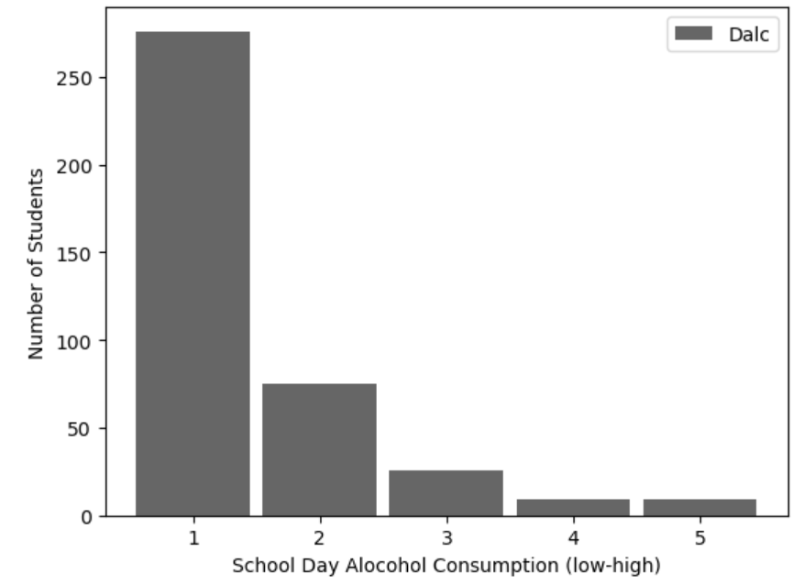
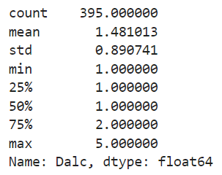
Dalc Histogram & Descriptive Statistics
Spread: Asymmetric distribution; right skewed
Tails: Tail to extending to the right

Slide 6
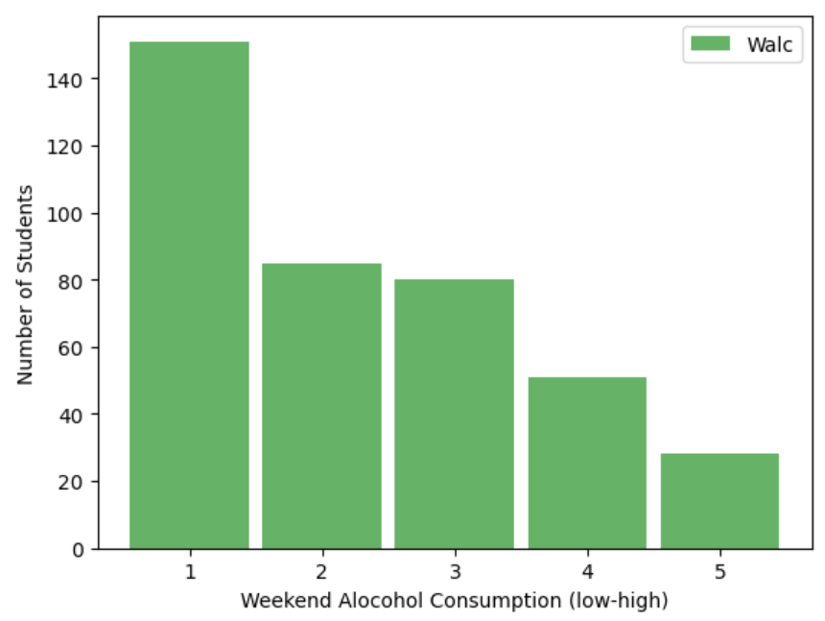
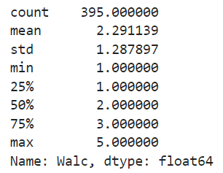
Walc Histogram & Descriptive Statistics
Spread: Asymmetric distribution; right skewed
Tails: Tail extending to the right

Slide 7
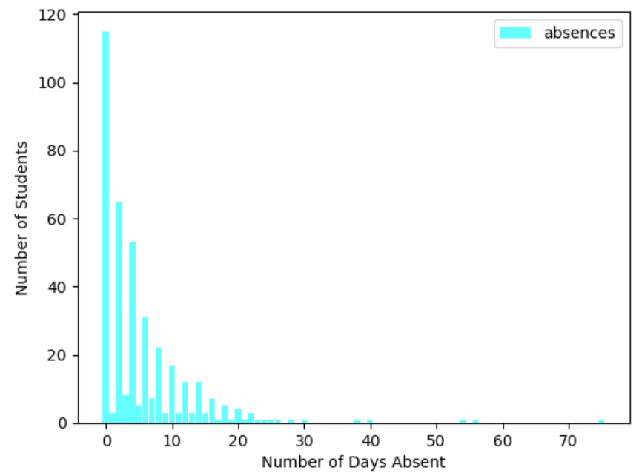
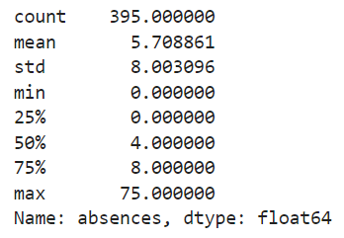
absences Histogram & Descriptive Statistics
Spread: Asymmetric distribution; right skewed
Tails: Tail to extending far to the right (outlier data identified)

Slide 8
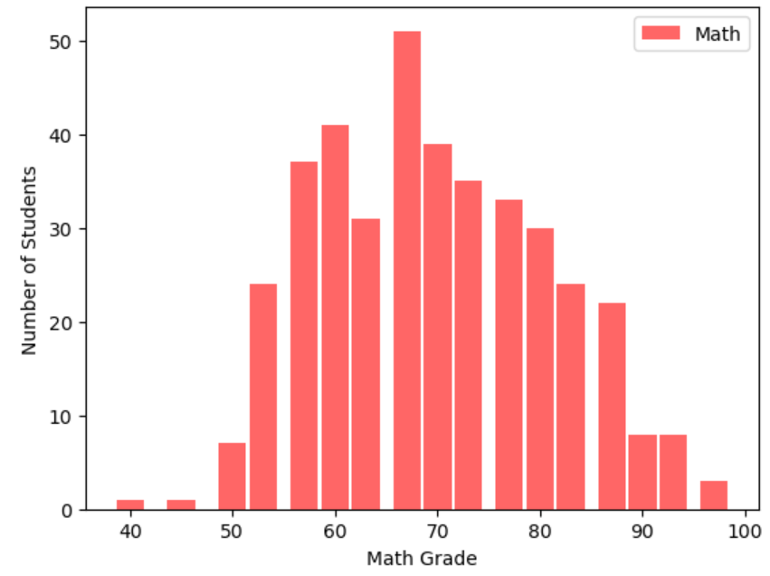
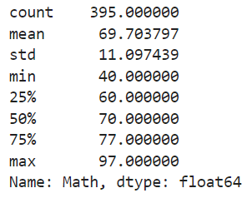
Math Histogram & Descriptive Statistics
Spread: Normal Distribution
Tails: Tails on both sides

Slide 9
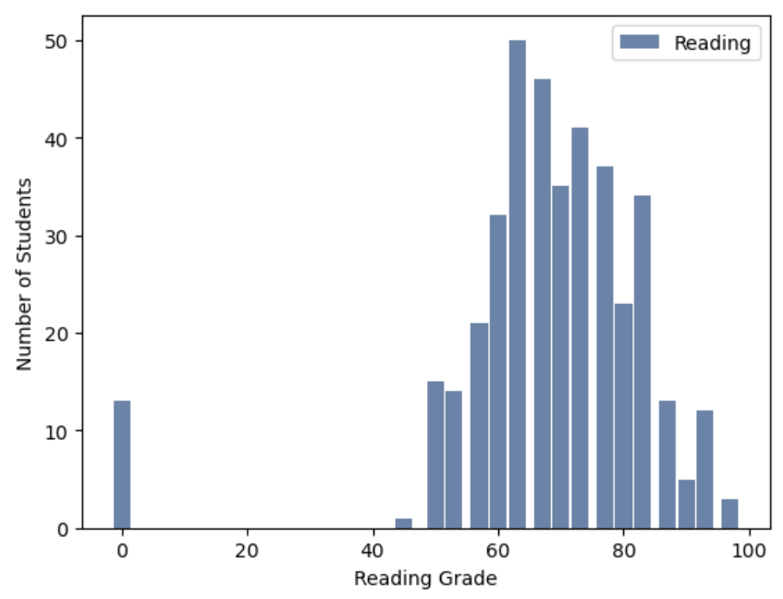
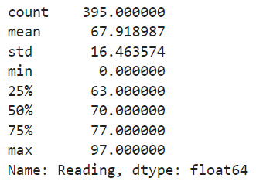
Reading Histogram & Descriptive Statistics
Spread: Normal distribution (when ignoring potential outlier data)
Tails: Tails on both sides... Outlier peak of data to the left of the distribution

Slide 10
Identifying Outliers
How do we identify outliers?
Observing data points on the histogram that are far away from the other data
Taking a closer look at the outliers using a boxplot
Defining outliers mathematically with Interquartile Range (IQR)
How do we handle outliers?
Ask questions about why the outliers exist:
Are they valid and explainable? – Consider leaving them in the data set
Are they a result of an error in data collection? – Consider removing them from the data set
Reading and absences were immediately identified as having possible outliers based on their histograms. We will look at these two variables first...

Slide 11
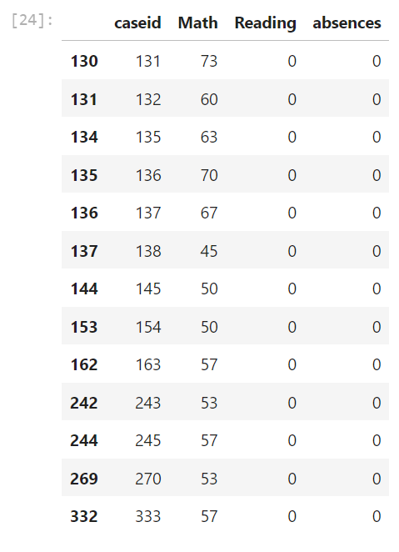
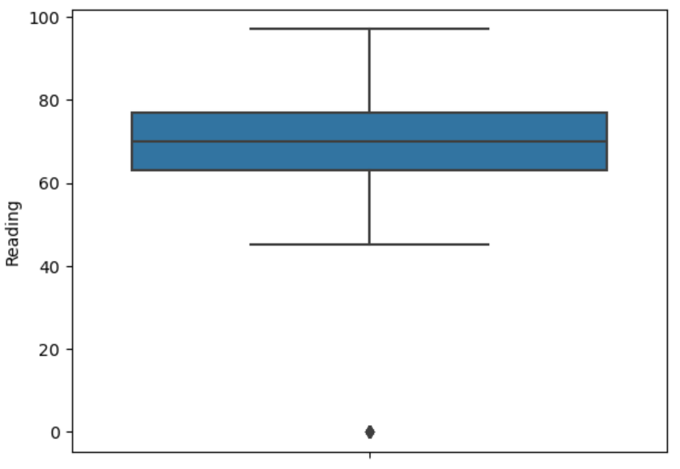
Identifying Outliers - Reading
There are 13 identified Reading outlier values below the lower limit threshold.
Questions to ask about these outliers:
Why do these students have 0 grade in Reading, but not Math?
Is reading the first class of the day for these students and they are coming to school tardy?
Are these 0 grades an error in the grading system?
Was there a missing reading grade for these students, but instead of null, a 0 was entered in its place?

Slide 12
Identifying Outliers - Reading
As a former teacher, domain expertise about this type of data and how student grades work will help me deal with these outliers.
The odds of a student receiving a 0 grade are very small in a classroom situation. Most students will do at least some work and earn a failing grade.
Earning a 0 grade comes from doing no work at all and/or never attending the class to begin with.
We can see that these students also have 0 absences, therefore we can conclude that these 0 grades must be an error.
Handling these outliers:
These errors in the data will skew the analysis of our statistical question, and therefore should be removed.

Slide 13
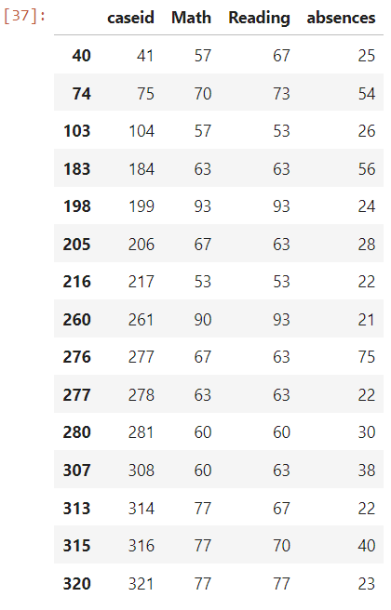
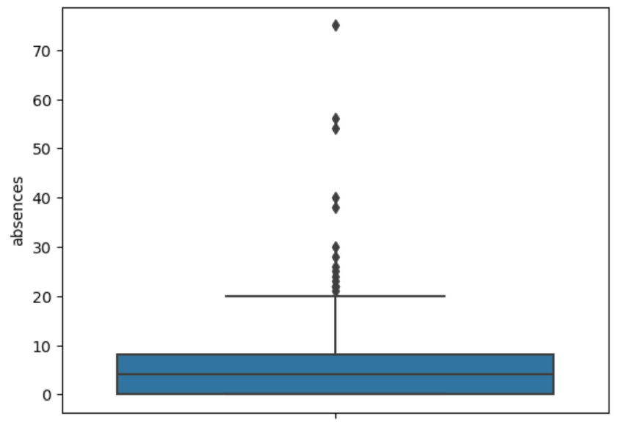
Identifying Outliers - absences
There are 15 identified absences outlier values below the lower limit threshold.
Questions to ask about these outliers:
There are 93 days recorded for this school year; Is it feasible that this many students could have as many as 50-75 absences during the school year?
Is it possible for the students with a high number of absences to still have passing Math & Reading grades?

Slide 14
Identifying Outliers - Reading
As a former teacher, domain expertise about this type of data and how student absences work will help me deal with these outliers.
The upper limit threshold for this data is 20 days; a feasible number of days for student absences.
I had multiple students absent more than 10 days a quarter, which equals more than 40 days a year.
Many of these students failed their classes due to missing work, however several students were able to maintain passing grades in their classes by keeping up with their classwork.
Therefore, students having such high absences and maintaining C and D grades, is feasible.
Handling these outliers:
Since these outliers are not viewed to be errors, then they can be left in the data set and used for the analysis of our statistical question.

Slide 15
Project Control Techniques
Standard Operating Procedures
Establish how and when the team will report their work
Monitor & Control Project Work
Utilize techniques to monitor and control project processes
Integrated Change Control
Formal process for the submission, documentation, and evaluation of change requests
(Schneider, et. al., 2020, p.424-430)

Slide 16
Project Control Techniques Cont.
Validate Scope
Assessment of produced deliverables based on stakeholder’s formal acceptance at sign-off
Control Scope
Protecting the project scope by only making agreed-upon changes
Control Schedule
Is the project progressing according to the project schedule?
(Schneider, et. al., 2020, p.433-436)

Slide 17
Project Control Techniques Cont.
Control Quality
Assessing whether project deliverables meet established quality standards
Control Resources
Ensuring the availability of resources and controlling their utilization and release (Bridges, J., 2015)
Monitor Risks
Monitoring identified risks, detecting new risks, and responding to risks as they occur
(Schneider, et. al., 2020, p.446-456)

Slide 18
Project Control Techniques Cont.
Control Procurements
Are the vendors meeting their contracted performance standards?
Monitor Communication & Stakeholder Engagement
Current information reaches the appropriate audience for the desired effectiveness of communication
Control Costs
Handling changes to the cost baseline
(Schneider, et. al., 2020, p.438, 457-458)

Slide 19

Control Costs
Earned Value Analysis
Measures performance over time
Estimate: Likelihood of meeting the projected schedule & budget
Key Values – Calculating Activity Costs
Planned Value (PV)
Earned Value (EV)
Actual Cost (AC)
(Schneider, et. al., 2020, p.439-441)

Slide 20

Control Costs Cont.
Cost Control Indexes
Cost Variance (CV)
Cost Performance Index (CPI)
Schedule Control Indexes
Schedule Variance (SV)
Schedule Performance Index (SPI)
(Schneider, et. al., 2020, p.442)

Slide 21

Project Closure
Every project has a start and an end, whether the project is deemed successful or not
Closing a project:
Final implementation & training, acceptance & signoff, and archiving documentation & lessons learned
Importance:
Gives the team assurance of the final signoff from the customer & an archive of lessons learned to reference in the future
(Kachigan, M., 2022)
(Bridges, J., 2015)
Notes:
Every project has a start and an end (Bridges, J., 2015).

Slide 22

Project Handover
Steps to handover the finalized project to the customer:
Finalizing project documentation
Obtaining approvals & signatures to close the contract
Transfer of responsibilities and deliverables
Customer training
Debrief project team members
(Donato, H., 2024)

Slide 23

Conclusion
Hands-on project control:
By being aware of the progress of project tasks, identifying and solving problems, and making appropriate changes to the project plan, a project manager can utilize a hands-on approach to managing the progress of a project.
Project wrap-up and closure:
A sometimes-neglected step, project wrap-up and closure is essential to a successful handover to the customer and archival of project documentation for use on future projects.

Slide 24
References:
Data Set:
P. Cortez and A. Silva. Using Data Mining to Predict Secondary School Student Performance. In A. Brito and J. Teixeira Eds., Proceedings of 5th FUture BUsiness TEChnology Conference (FUBUTEC 2008) pp. 5-12, Porto, Portugal, April, 2008, EUROSIS, ISBN 978-9077381-39-7.

Slide 25
Image References:
BBC. (2014, July 24). Smoking, Drinking and Drug Use Down in Young, Report Says. BBC News. [Photograph] https://www.bbc.co.uk/news/health-28461530

